Slide 1
Modeling and Simulation of Magnetic Transmission Lines
Muhammad Shamaas
2018-MS-EE-4
Supervisor: Dr. Muhammad Asghar Saqib

Slide 2
Research Objectives
Model dispersive, inhomogeneous and non-linear Magnetic Transmission Lines.
Study equivalent magnetic circuits using Reluctance Model, Permeance-Capacitance Model and Transmission Line Model.
Simulate Magnetic Transmission Lines using Finite Difference Time Domain (FDTD) Simulator MEEP.
Study Frequency Domain Behavior of Magnetic Transmission Line parameters.

Slide 3
1. Introduction to Magnetic Transmission

Slide 4
1.1. Introduction to Solid State Magnetism

Slide 5
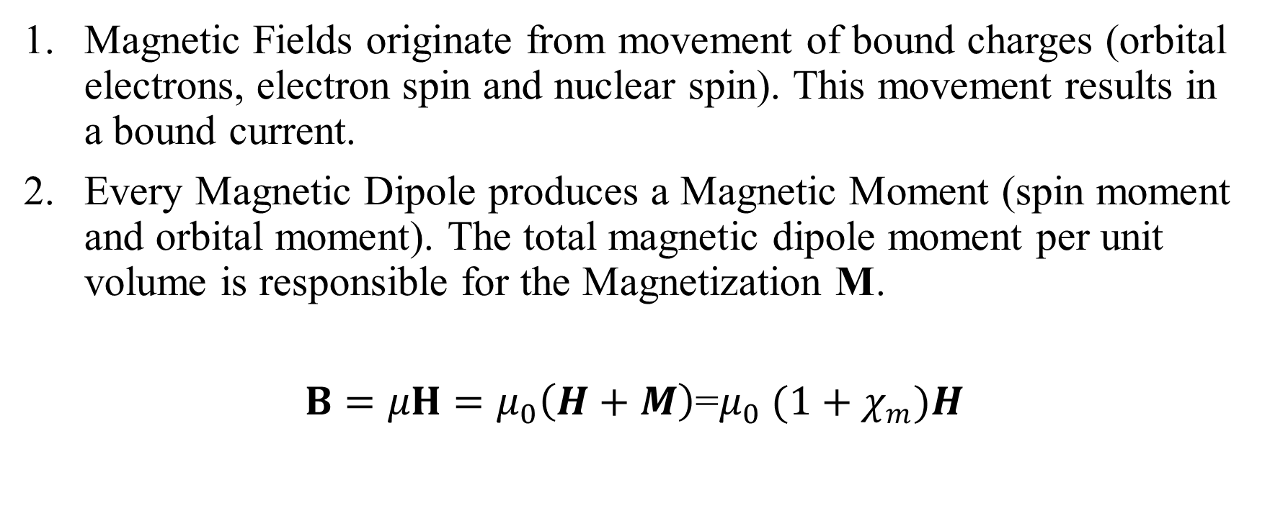
1.1. Magnetization and Permeability
Magnetic Fields originate from movement of bound charges (orbital electrons, electron spin and nuclear spin). This movement results in a bound current.
Every Magnetic Dipole produces a Magnetic Moment (spin moment and orbital moment). The total magnetic dipole moment per unit volume is responsible for the Magnetization M.
$B=μH=μ_{0}\left(H+M\right)$=$μ_{0}$ ${(1+χ}_{m})H$

Slide 6
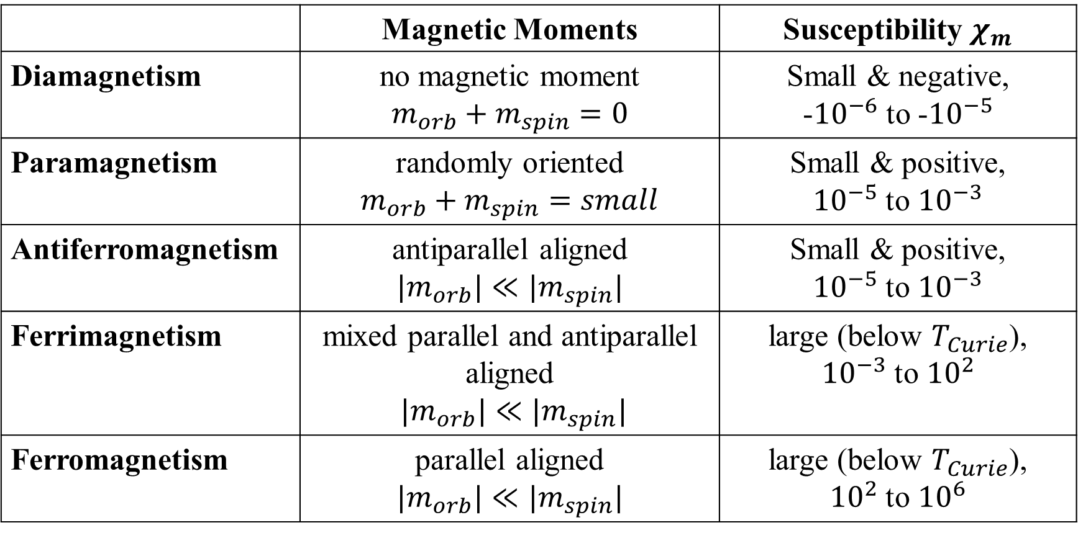
1.1. Properties of Magnetic Materials
 | Magnetic Moments | Susceptibility $χ_{m}$
Diamagnetism | no magnetic moment $$m_{orb}+m_{spin}=0$$ | Small & negative, -${10}^{−6}$ to -${10}^{−5}$
Paramagnetism | randomly oriented $$m_{orb}+m_{spin}=small$$ | Small & positive, ${10}^{−5}$ to ${10}^{−3}$
Antiferromagnetism | antiparallel aligned $$|m_{orb}|≪|m_{spin}|$$ | Small & positive, ${10}^{−5}$ to ${10}^{−3}$
Ferrimagnetism | mixed parallel and antiparallel aligned $|m_{orb}|≪|m_{spin}|$ | large (below $T_{Curie}$), ${10}^{−3}$ to ${10}^{2}$
Ferromagnetism | parallel aligned $$|m_{orb}|≪|m_{spin}|$$ | large (below $T_{Curie}$), ${10}^{2}$ to ${10}^{6}$

Slide 7
1.1. Magnetic Susceptibility
When a ferromagnetic material is magnetized, the susceptibility follows the a non-linear curve.
When the material is saturated, the magnetic susceptibility becomes zero.
Besides Magnetic Field Intensity, permeability is strongly dependent on chemical composition, crystal structure, stress, temperature and time after magnetization

Slide 8
1.1. Magnetic Hysteresis
Ferromagnetic materials are non-linear as their permeability varies with the strength of applied field intensity.
The flux in a ferromagnetic material depends on the instantaneous Magnetomotive force and its history.
At high magnetic field intensity, the material saturates, limiting further increase of Magnetic Flux.

Slide 9
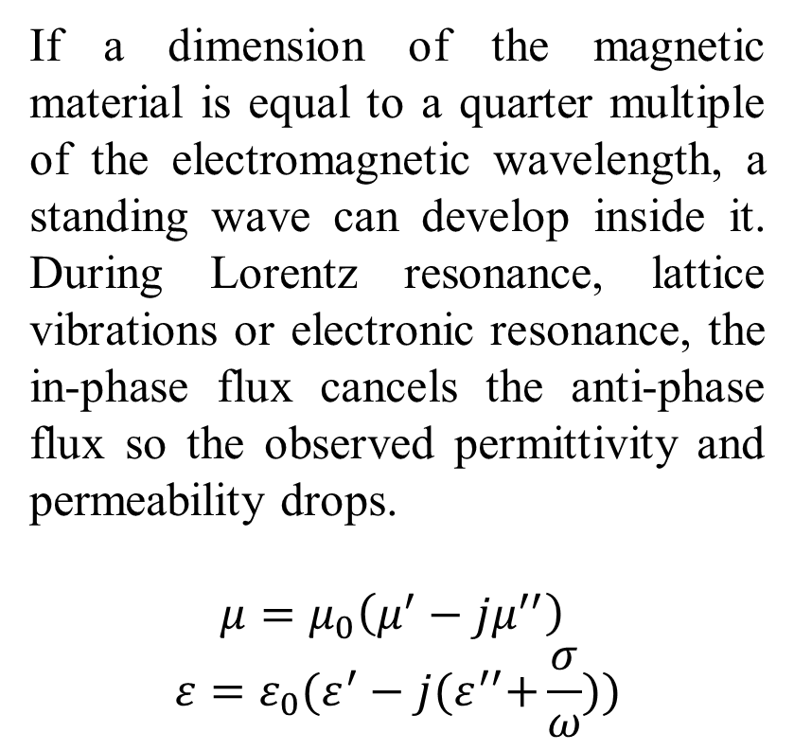
1.1. Dielectric and Diamagnetic Losses
If a dimension of the magnetic material is equal to a quarter multiple of the electromagnetic wavelength, a standing wave can develop inside it. During Lorentz resonance, lattice vibrations or electronic resonance, the in-phase flux cancels the anti-phase flux so the observed permittivity and permeability drops.
$$μ=μ_{0}\left(μ^{′}−jμ^{′′}\right)$$
$$ε=ε_{0}(ε^{′}−j{(ε}^{′′}+\frac{σ}{ω}))$$

Slide 10
1.2. Introduction to Magnetic Transmission Lines

Slide 11
1.2. Introduction to Magnetic Transmission Lines
Magnetic Transmission Lines are made from a magnetic material, with a very high relative permeability.
They transmit Magnetic Flux as the effective Magnetic charge. Time varying magnetic flux results in a Magnetic Displacement Current inside the Transmission Line.
The operation of a Magnetic Transmission Line does not involve flow of magnetic or electric charges. They are very poor electrical conductors. However, changing Magnetic Fields produce Electric Fields and Electrical Energy is stored in the dielectric medium.
Together, the Electric and Magnetic Fields transmit Energy along the direction of propagation.

Slide 12
1.2. Applications of Magnetic Transmission Lines
Inductors and Magnetic Amplifiers.
Filters and Wideband/ Pulse Transformers.
Alternating Current and Direct Current Machines.
Magnetic Memory, Spintronic and Nanomagnetic Logic Devices
Directional Couplers and Magnetometers.
Induction Heaters and Magneto-resistive Sensors.
Gyromagnetic Devices, Microwave generators and Magnetic Resonance Imaging.

Slide 13
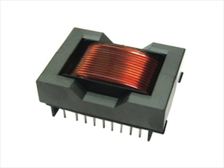
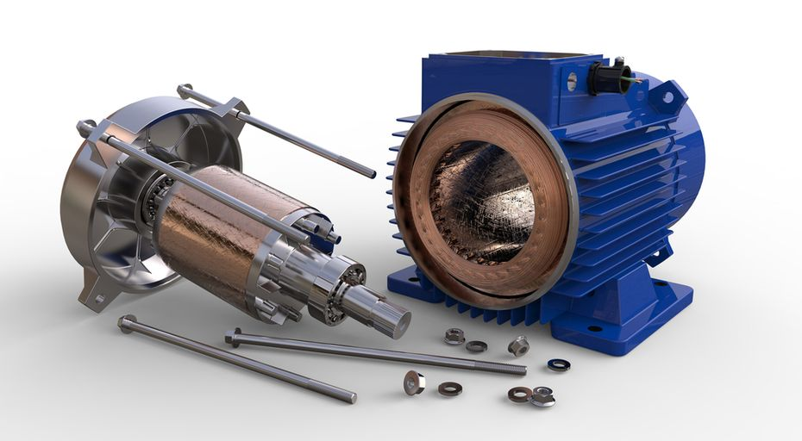
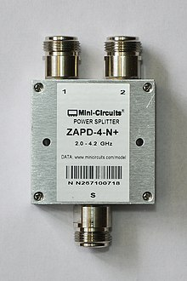
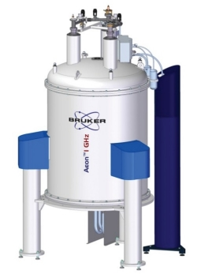
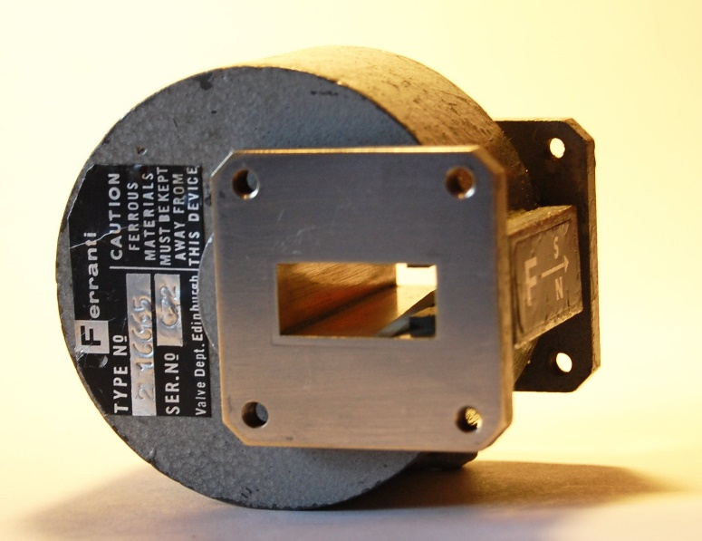
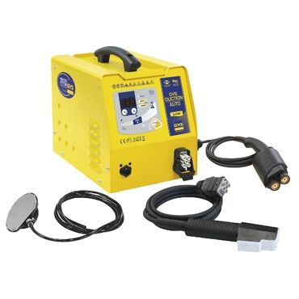
1.2. Applications of Magnetic Transmission Lines

Slide 14
2. Magnetic Circuit Modeling

Slide 15
2. Three Magnetic Circuit Models
This chapter discusses three magnetic circuit models:
Reluctance Model
Permeance-Capacitance Model
Magnetic Transmission Line Model

Slide 16
2.1. Magnetic Reluctance Model

Slide 17
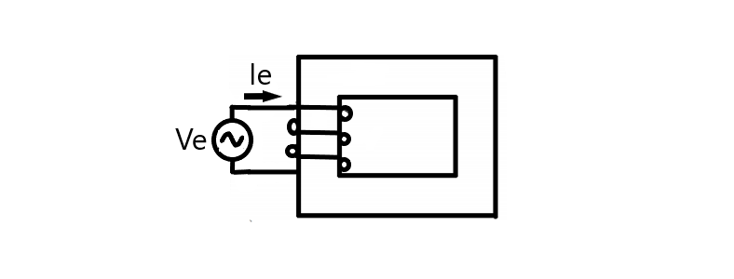
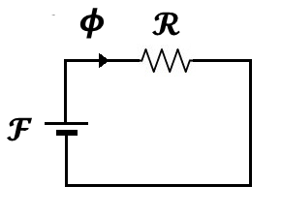
2.1. Complex Magnetic Reluctance Model for Magnetic Circuits

Slide 18
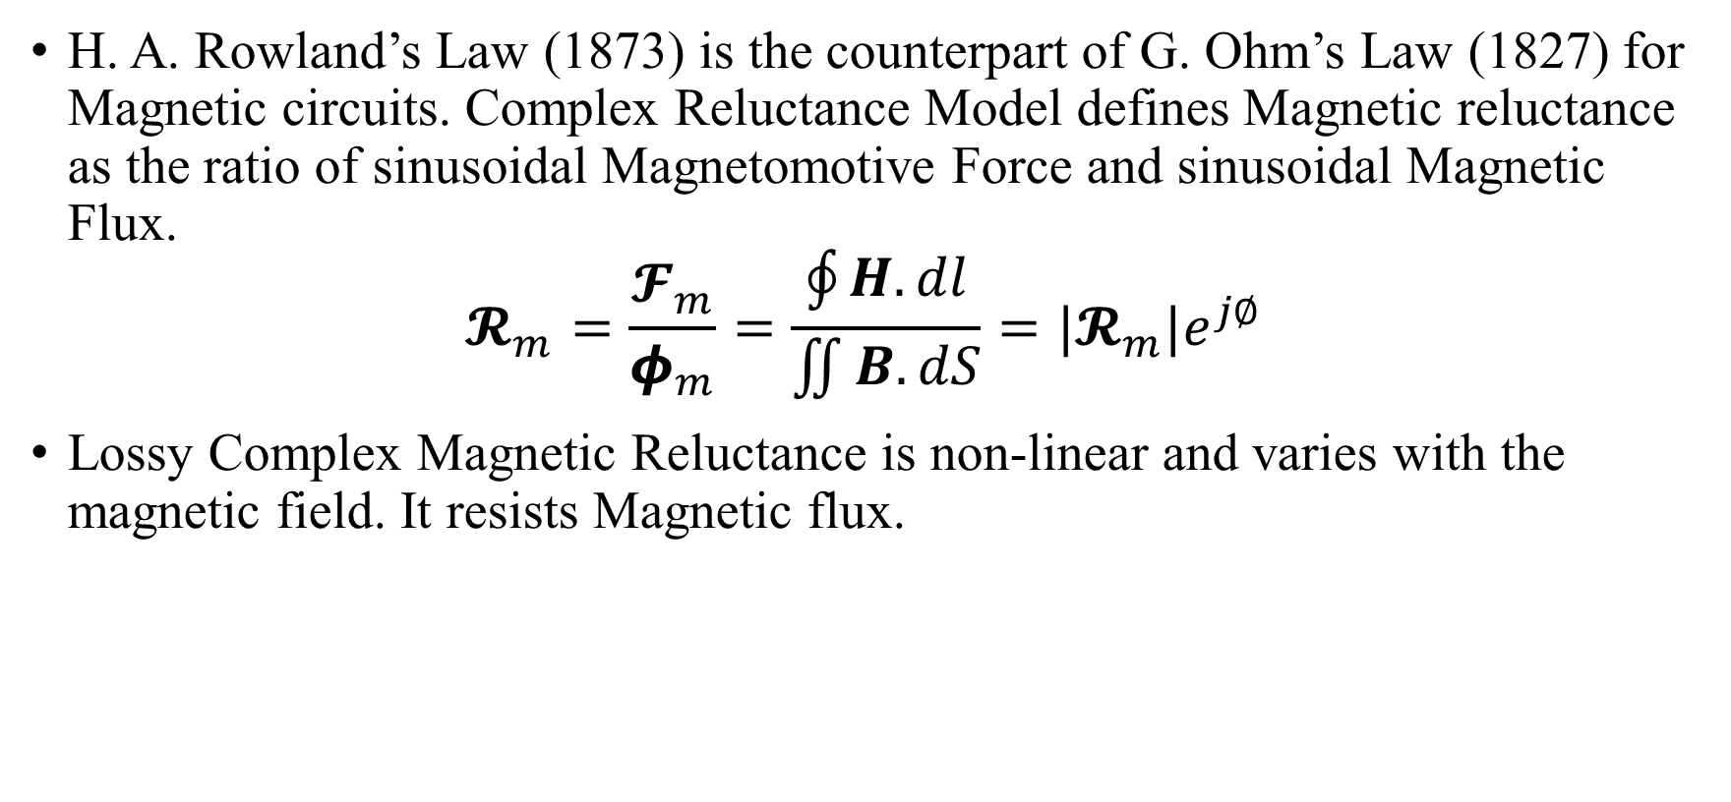
2.1. Complex Magnetic Reluctance Model for Magnetic Circuits
H. A. Rowland’s Law (1873) is the counterpart of G. Ohm’s Law (1827) for Magnetic circuits. Complex Reluctance Model defines Magnetic reluctance as the ratio of sinusoidal Magnetomotive Force and sinusoidal Magnetic Flux.
$$𝓡_{m}=\frac{𝓕_{m}}{φ_{m}}=\frac{\oint{H.dl}}{\iint{B.dS}}=|𝓡_{m}|e^{j∅}$$
Lossy Complex Magnetic Reluctance is non-linear and varies with the magnetic field. It resists Magnetic flux.

Slide 19
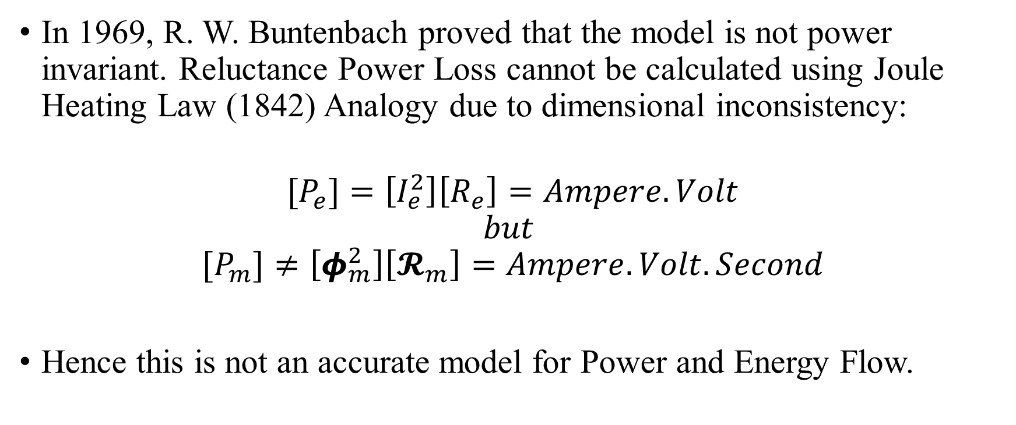
2.1. Inconsistency in Complex Magnetic Reluctance Model
In 1969, R. W. Buntenbach proved that the model is not power invariant. Reluctance Power Loss cannot be calculated using Joule Heating Law (1842) Analogy due to dimensional inconsistency:
$$[P_{e}]=\left[I_{e}^{2}\right]\left[R_{e}\right]=Ampere.Volt$$
$$but$$
$${[P}_{m}]≠\left[φ_{m}^{2}\right]\left[𝓡_{m}\right]=Ampere.Volt.Second$$
Hence this is not an accurate model for Power and Energy Flow.

Slide 20
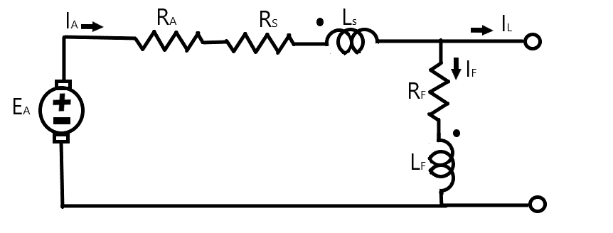
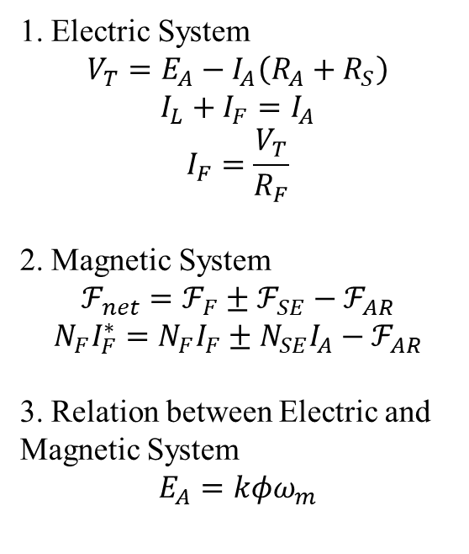
2.1. Reluctance model for a Compounded DC Generator
1. Electric System
$$V_{T}=E_{A}−I_{A}\left(R_{A}+R_{S}\right)$$
$$I_{L}+I_{F}=I_{A}$$
$$I_{F}=\frac{V_{T}}{R_{F}}$$
2. Magnetic System
$$ℱ_{net}=ℱ_{F}±ℱ_{SE}−ℱ_{AR}$$
$$N_{F}I_{F}^{∗}=N_{F}I_{F}±N_{SE}I_{A}−ℱ_{AR}$$
3. Relation between Electric and Magnetic System
$$E_{A}=kφω_{m}$$

Slide 21
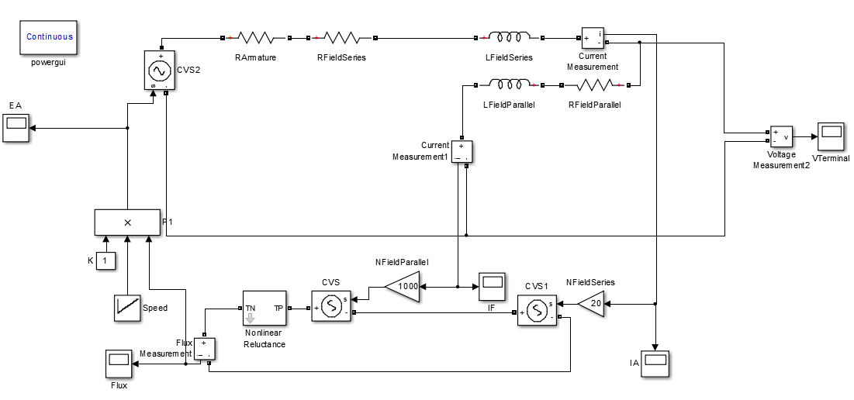
2.1. Simulation of Reluctance model for a Compounded DC Generator
Parameters:
R_{A}=0.19 Ω
R_{S}=0.02 Ω
R_{F}=20-50Ω
N_{F}=1000 turns
N_{S}=20 turns
Rated speed=1800 rpm.
Rated Voltage=140 V.

Slide 22
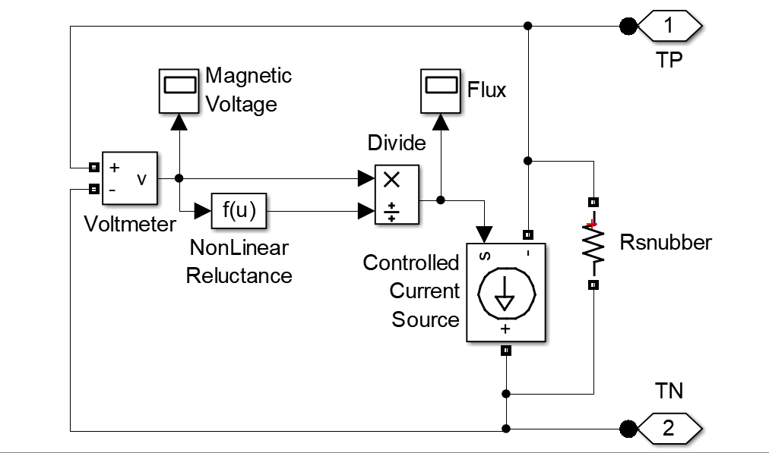
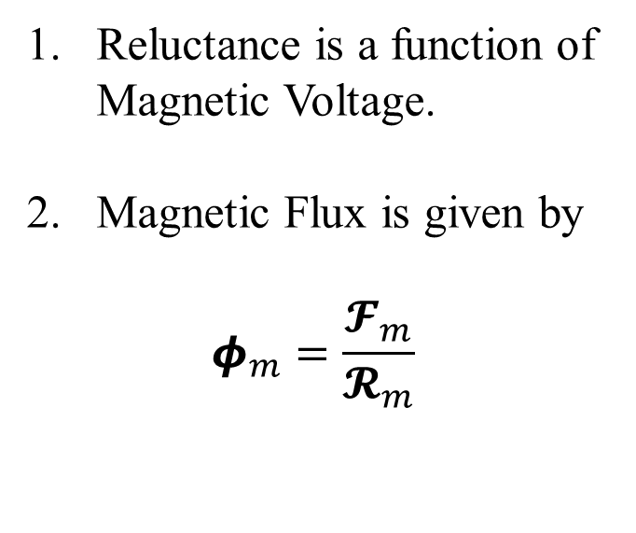
2.1. Simulation of Non-Linear Reluctance
Reluctance is a function of Magnetic Voltage.
Magnetic Flux is given by
$$φ_{m}=\frac{𝓕_{m}}{𝓡_{m}}$$

Slide 23
2.1. Simulation of Non-Linear Reluctance

Slide 24
2.1. Simulation of Reluctance model for a Compounded DC Generator
The rotor mechanical speed was increased from 500 to 2000 rpm in steps of 500rpm.
Reluctance model is only suitable for steady state simulations of machines if the reluctance profile of the magnetic core and the voltage/ flux relation is known.

Slide 25
2.2. Permeance-Capacitance Model

Slide 26
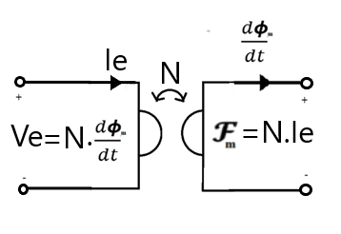
2.2. Tellegen’s Gyrator theory
B. Tellegen’s Gyrator theory (1948) can describe power invariant transformation of magnetic and electric quantities. The dual effort and flow quantities are related by the gyration constant N.

Slide 27
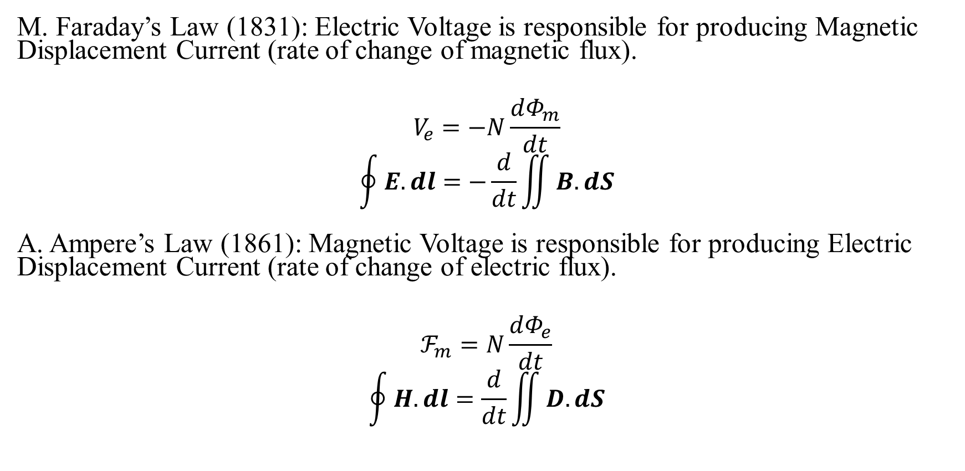
2.2. Validation of Gyrator Theory
M. Faraday’s Law (1831): Electric Voltage is responsible for producing Magnetic Displacement Current (rate of change of magnetic flux).
$$V_{e}=−N\frac{dΦ_{m}}{dt}$$
$$\oint{E.dl}=−\frac{d}{dt}\iint{B.dS}$$
A. Ampere’s Law (1861): Magnetic Voltage is responsible for producing Electric Displacement Current (rate of change of electric flux).
$$ℱ_{m}=N\frac{dΦ_{e}}{dt}$$
$$\oint{H.dl}=\frac{d}{dt}\iint{D.dS}$$

Slide 28
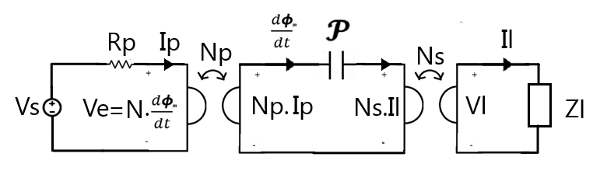
2.2. Power Invariant Permeance-Capacitance Model (1969)
R. W. Buntenbach proposed Power Invariant Permeance-Capacitance Model (1969) to replace Reluctance Model.
Magnetic Displacement Current is the rate of change of Magnetic Flux which results from the polarization of Magnetic Dipoles.

Slide 29
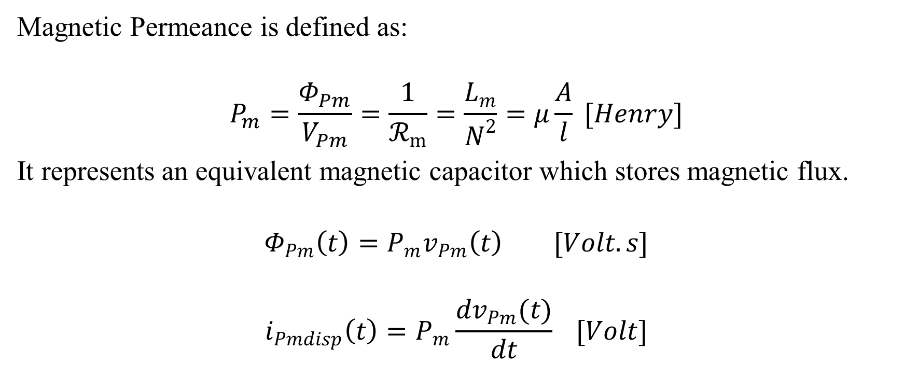
2.2. Nature of Magnetic Permeance
Magnetic Permeance is defined as:
$$P_{m}=\frac{Φ_{Pm}}{V_{Pm}}=\frac{1}{ℛ_{m}}=\frac{L_{m}}{N^{2}}=μ\frac{A}{l} [Henry]$$
It represents an equivalent magnetic capacitor which stores magnetic flux.
$$Φ_{Pm}\left(t\right)=P_{m}v_{Pm}\left(t\right) [Volt.s]$$
$$i_{Pmdisp}\left(t\right)=P_{m}\frac{dv_{Pm}(t)}{dt} [Volt]$$

Slide 30
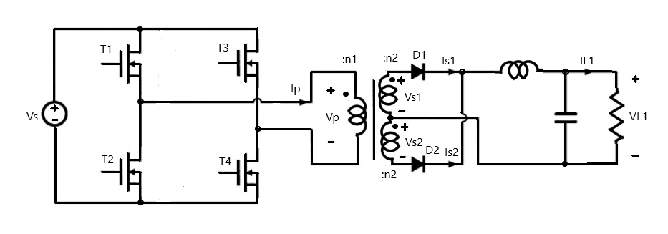
2.2. Permeance-Capacitance Model for a full bridge Isolated Buck Converter

Slide 31
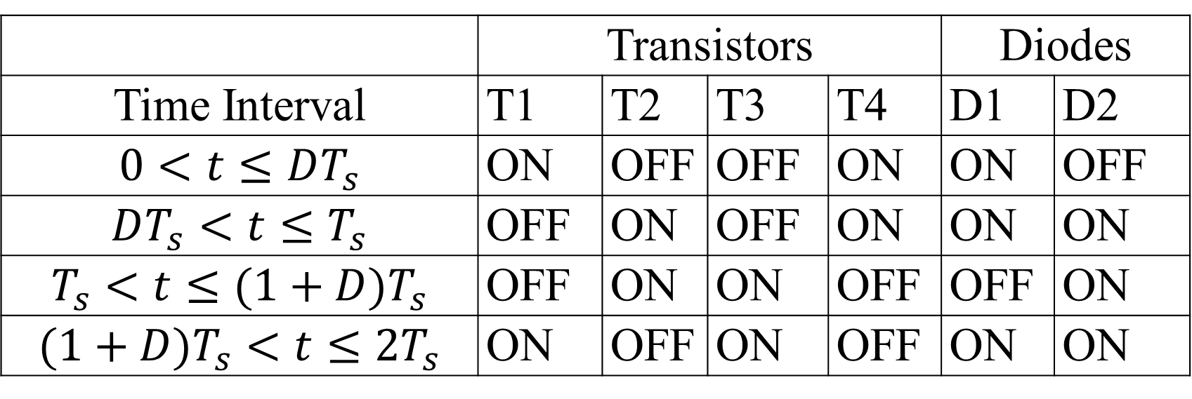
2.2. The switching table for the switches and diodes
 | Transistors |  |  |  | Diodes
Time Interval | T1 | T2 | T3 | T4 | D1 | D2
$$0<t≤DT_{s}$$ | ON | OFF | OFF | ON | ON | OFF
$$DT_{s}<t≤T_{s}$$ | OFF | ON | OFF | ON | ON | ON
$$T_{s}<t≤(1+D)T_{s}$$ | OFF | ON | ON | OFF | OFF | ON
$$(1+D)T_{s}<t≤2T_{s}$$ | ON | OFF | ON | OFF | ON | ON

Slide 32
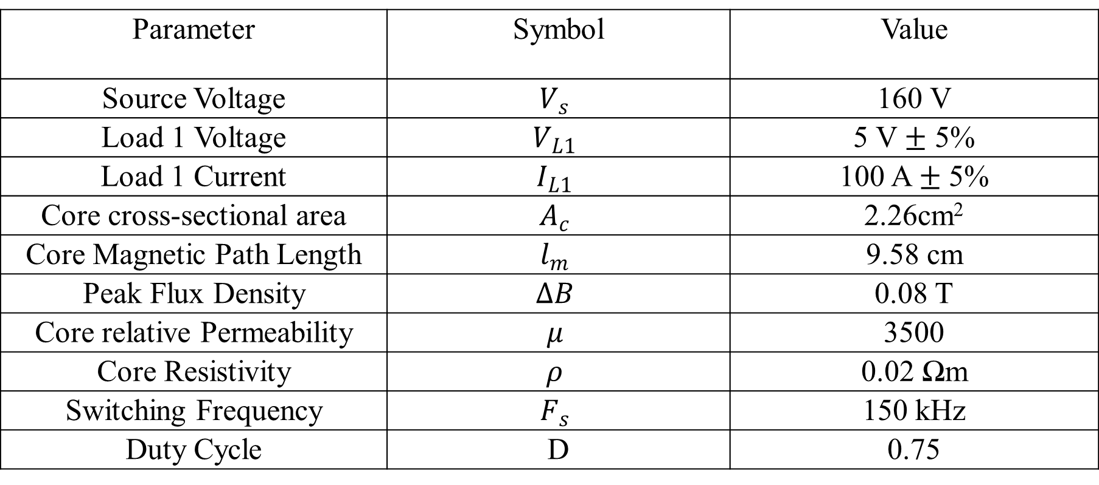
2.2. The design parameters
Parameter | Symbol | Value
Source Voltage | $$V_{s}$$ | 160 V
Load 1 Voltage | $$V_{L1}$$ | 5 V $±$ 5%
Load 1 Current | $$I_{L1}$$ | 100 A $±$ 5%
Core cross-sectional area | $$A_{c}$$ | 2.26cm²
Core Magnetic Path Length | $$l_{m}$$ | 9.58 cm
Peak Flux Density | $$∆B$$ | 0.08 T
Core relative Permeability | $$μ$$ | 3500
Core Resistivity | $$ρ$$ | 0.02 Ωm
Switching Frequency | $$F_{s}$$ | 150 kHz
Duty Cycle | D | 0.75

Slide 33

2.2. The Design Procedure
1. Applied Primary winding flux
$$λ_{p}=\int_{0}^{Ts}{Vp\left(t\right) dt}=DT_{s}V_{s}=8×{10}^{−4} V.s$$
2. Turns of Primary winding
$$n_{1}=\frac{λ_{p}}{2∆BA_{c}}≈22$$
3. Turns of Secondary windings
$$n_{2}=\frac{V_{L1}+V_{Diode,on}}{Vs}n_{1}≈1$$
4. Core Permeance
$$P_{m,max}=\frac{μA_{c}}{l_{m}}=10.3 μH, P_{m,min}=\frac{μ_{o}A_{c}}{l_{m}}=2.94 nH$$
5.Core Resistance
$$R_{c}=\frac{ρl_{m}}{A_{c}}=8.48Ω$$
6. Load Filter Design
$L_{filter}=\frac{(1−D)T_{s}}{∆I_{L1}}V_{L1}=1.7μH$, $C_{filter}=\frac{(1−D)T_{s}}{∆V_{L1}}I_{L1}=67nF$

Slide 34
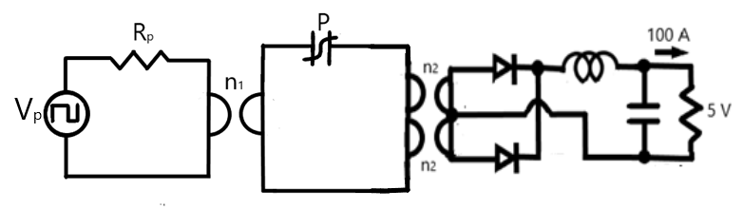
2.2. Permeance-Capacitance Model for a full bridge Isolated Buck Converter

Slide 35
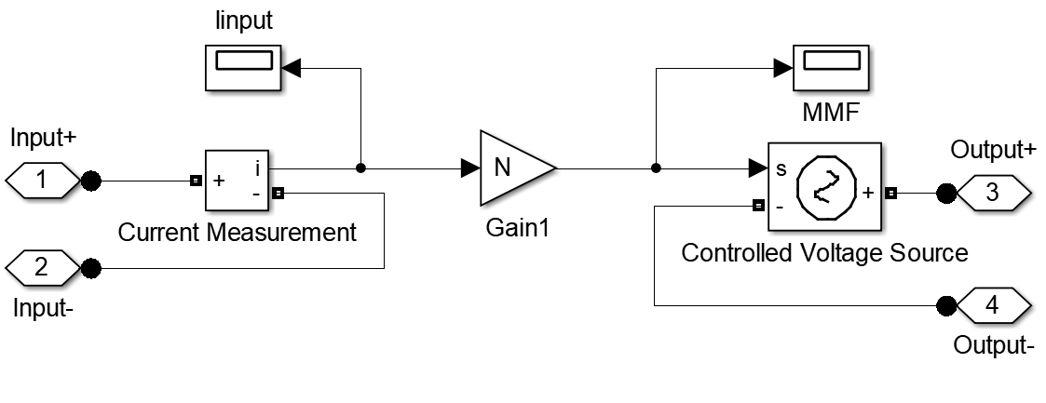
2.2. Model for Primary winding gyrator

Slide 36
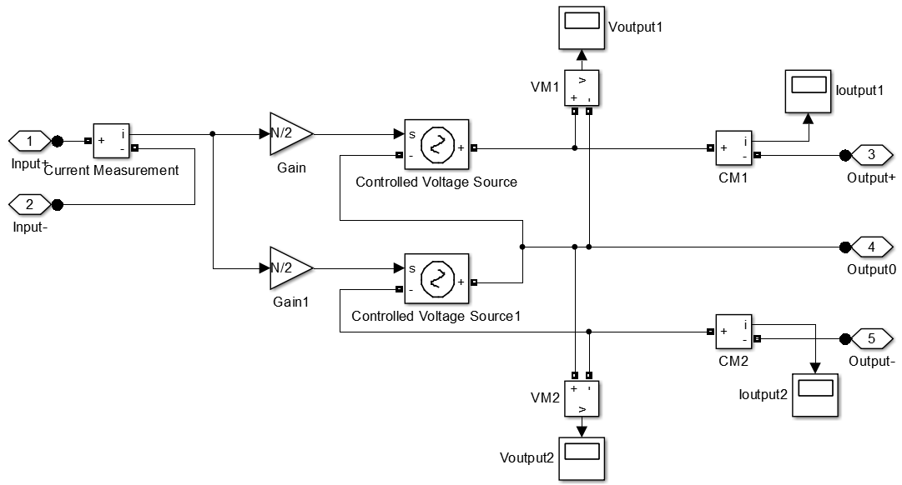
2.2. Model for Secondary winding gyrators

Slide 37
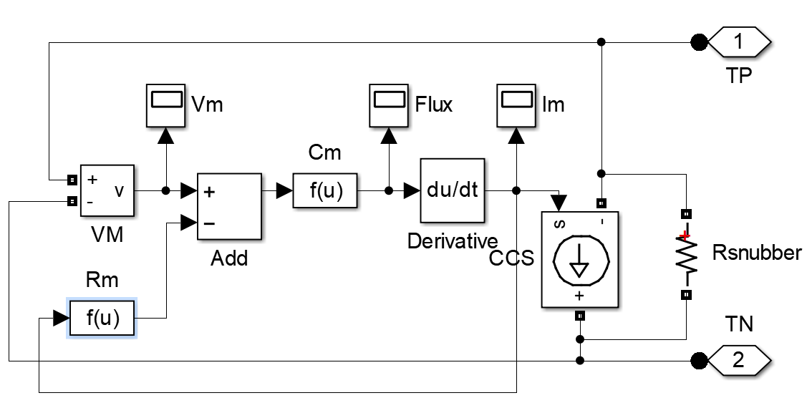
2.2. Model for non-linear Permeance

Slide 38
2.2. Sample Response of non-linear Permeance

Slide 39
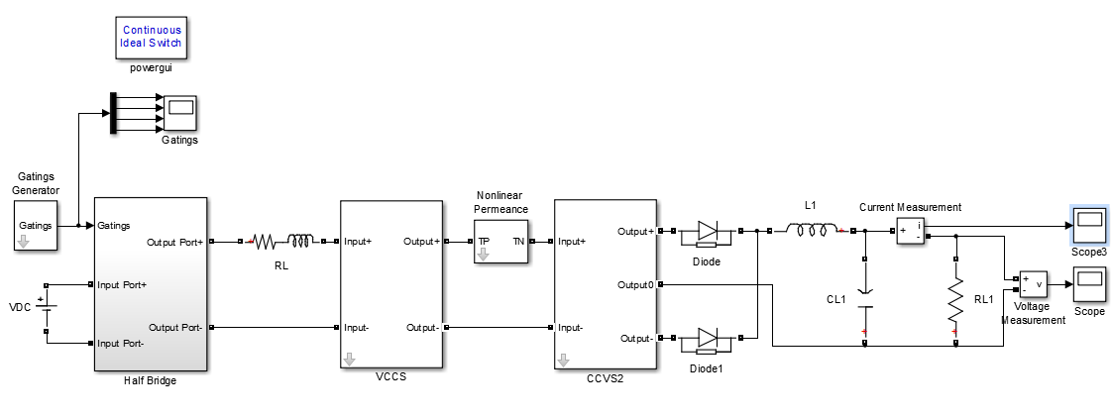
2.2. Simulation Model of full bridge Isolated Buck Converter

Slide 40
2.2. Source and Load waveforms

Slide 41
2.2. Permeance Magnetic Voltage and Magnetic Displacement Current
The Permeance-Capacitance model uses a non-linear Permeance to model nonlinearity and hysteresis losses of magnetic materials.
It is valuable for simulating transient behavior of Ferromagnetic elements like RF inductors, transformers and filters.

Slide 42
2.3.Magnetic Transmission Line Model

Slide 43
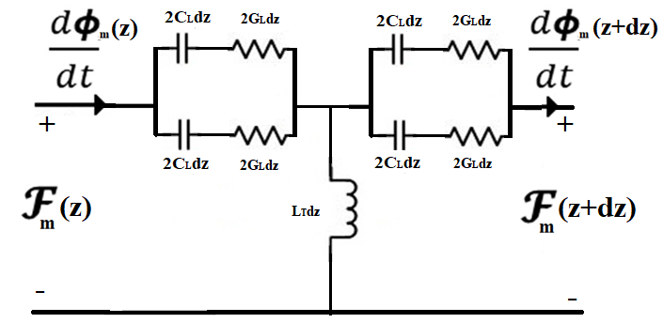
2.3. Magnetic Transmission Line Model (2012)
J. A. B. Faria and M.P. Pires presented Magnetic Transmission Line Model (2012) based on Electric Transmission Line Model in terms of per unit length Transverse Impedance and per unit length Longitudinal Admittance.

Slide 44
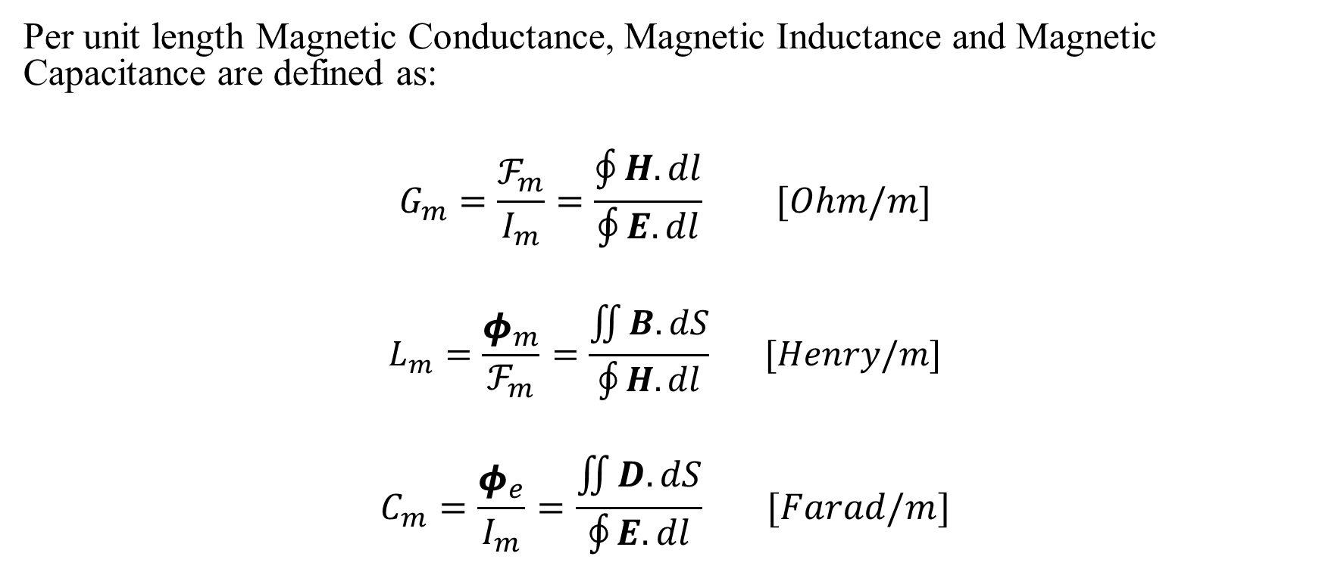
2.3. Components in Transmission Line Model
Per unit length Magnetic Conductance, Magnetic Inductance and Magnetic Capacitance are defined as:
$$G_{m}=\frac{ℱ_{m}}{I_{m}}=\frac{\oint{H.dl}}{\oint{E.dl}} [Ohm/m]$$
$$L_{m}=\frac{φ_{m}}{ℱ_{m}}=\frac{\iint{B.dS}}{\oint{H.dl}} [Henry/m]$$
$$C_{m}=\frac{φ_{e}}{I_{m}}=\frac{\iint{D.dS}}{\oint{E.dl}} [Farad/m]$$

Slide 45
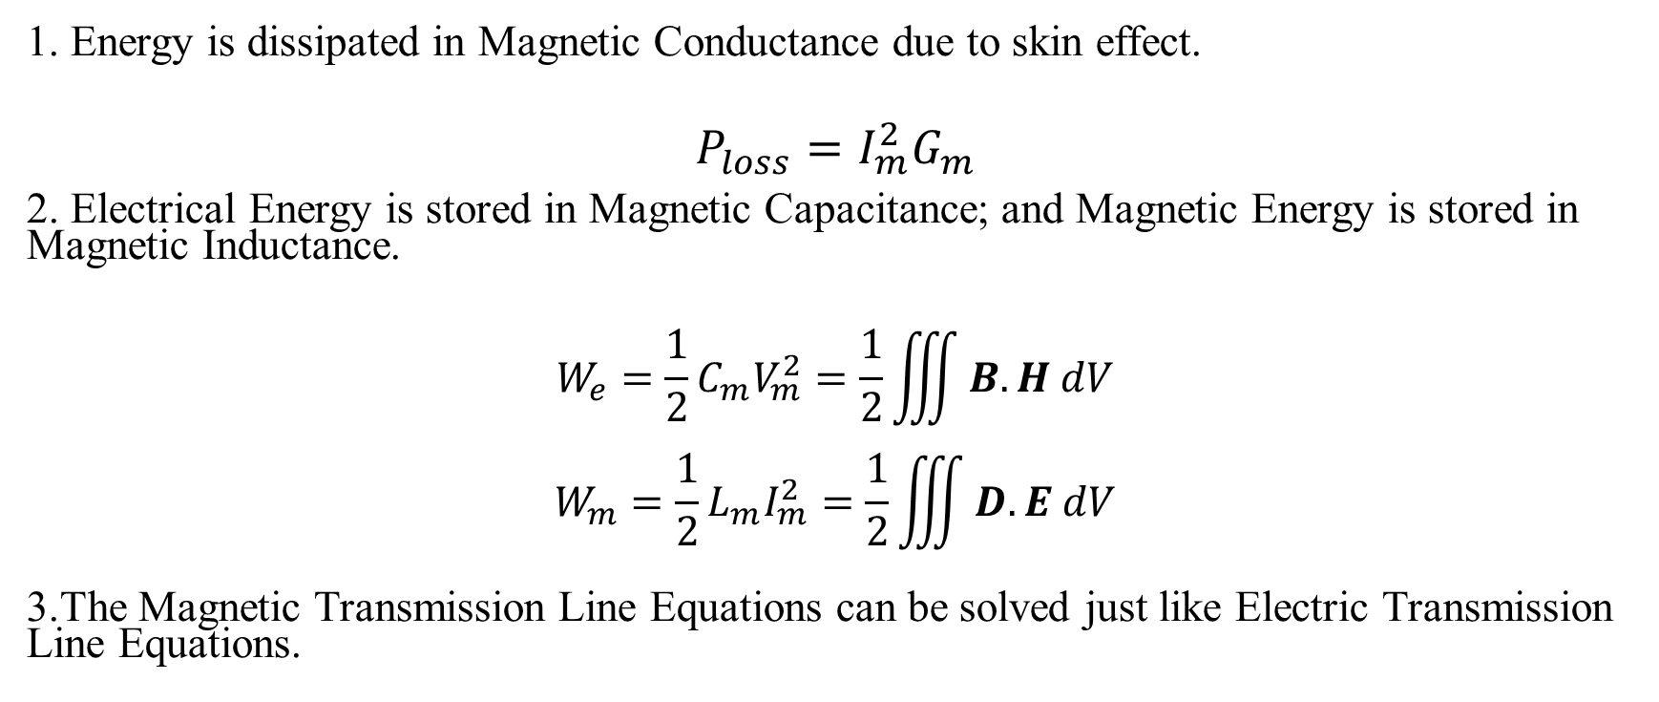
2.3. Energy Loss and Energy Storage
1. Energy is dissipated in Magnetic Conductance due to skin effect.
$$P_{loss}=I_{m}^{2}G_{m}$$
2. Electrical Energy is stored in Magnetic Capacitance; and Magnetic Energy is stored in Magnetic Inductance.
$$W_{e}=\frac{1}{2}{C_{m}V}_{m}^{2}=\frac{1}{2}\iiint{B.H dV}$$
$$W_{m}=\frac{1}{2}{L_{m}I}_{m}^{2}=\frac{1}{2}\iiint{D.E dV}$$
3.The Magnetic Transmission Line Equations can be solved just like Electric Transmission Line Equations.

Slide 46
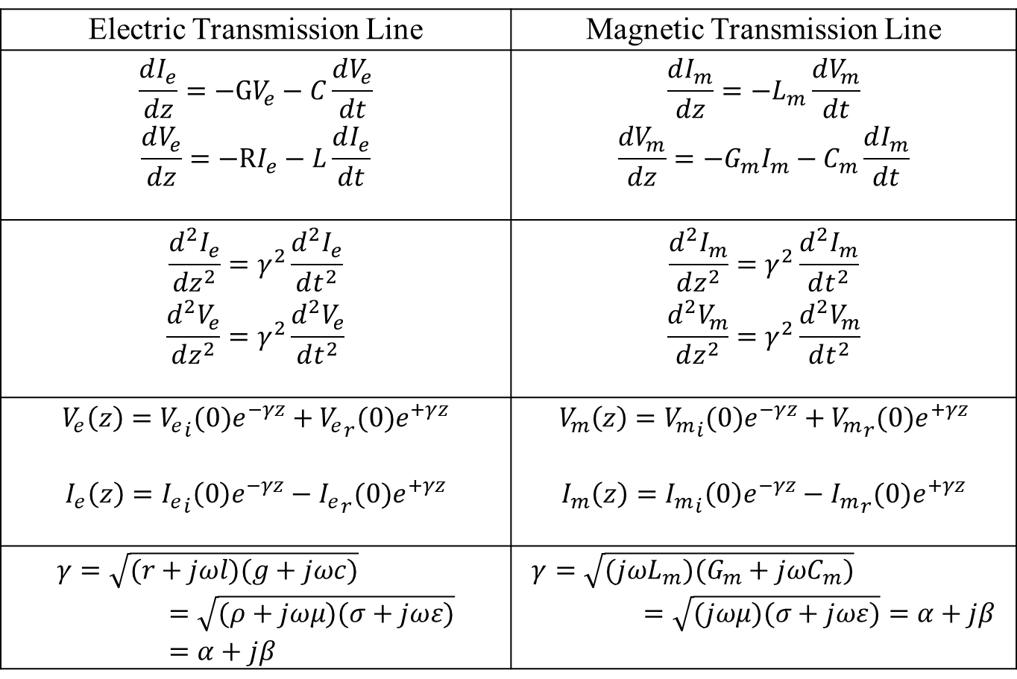
2.3. Lossy Transmission Lines
Electric Transmission Line | Magnetic Transmission Line
$$\frac{dI_{e}}{dz}=−GV_{e}−C\frac{dV_{e}}{dt}$$ $$\frac{dV_{e}}{dz}=−RI_{e}−L\frac{dI_{e}}{dt}$$ | $$\frac{dI_{m}}{dz}=−L_{m}\frac{dV_{m}}{dt}$$ $$\frac{dV_{m}}{dz}=−G_{m}I_{m}−C_{m}\frac{dI_{m}}{dt}$$
$$\frac{d^{2}I_{e}}{dz^{2}}=γ^{2}\frac{d^{2}I_{e}}{dt^{2}}$$ $$\frac{d^{2}V_{e}}{dz^{2}}=γ^{2}\frac{d^{2}V_{e}}{dt^{2}}$$ | $$\frac{d^{2}I_{m}}{dz^{2}}=γ^{2}\frac{d^{2}I_{m}}{dt^{2}}$$ $$\frac{d^{2}V_{m}}{dz^{2}}=γ^{2}\frac{d^{2}V_{m}}{dt^{2}}$$
$$V_{e}\left(z\right)={V_{e}}_{i}(0)e^{−γz}+{V_{e}}_{r}(0)e^{+γz}$$ $$I_{e}\left(z\right)={I_{e}}_{i}\left(0\right)e^{−γz}−{I_{e}}_{r}(0)e^{+γz}$$ | $$V_{m}\left(z\right)={V_{m}}_{i}(0)e^{−γz}+{V_{m}}_{r}(0)e^{+γz}$$ $$I_{m}\left(z\right)={I_{m}}_{i}\left(0\right)e^{−γz}−{I_{m}}_{r}(0)e^{+γz}$$
$$γ=\sqrt{(r+jωl)(g+jωc)}=\sqrt{(ρ+jωμ)(σ+jωε)}=α+jβ$$ | $$γ=\sqrt{(jωL_{m})(G_{m}+jωC_{m})}=\sqrt{(jωμ)(σ+jωε)}=α+jβ$$

Slide 47
2.4. Summary of Three Magnetic Circuit Models

Slide 48
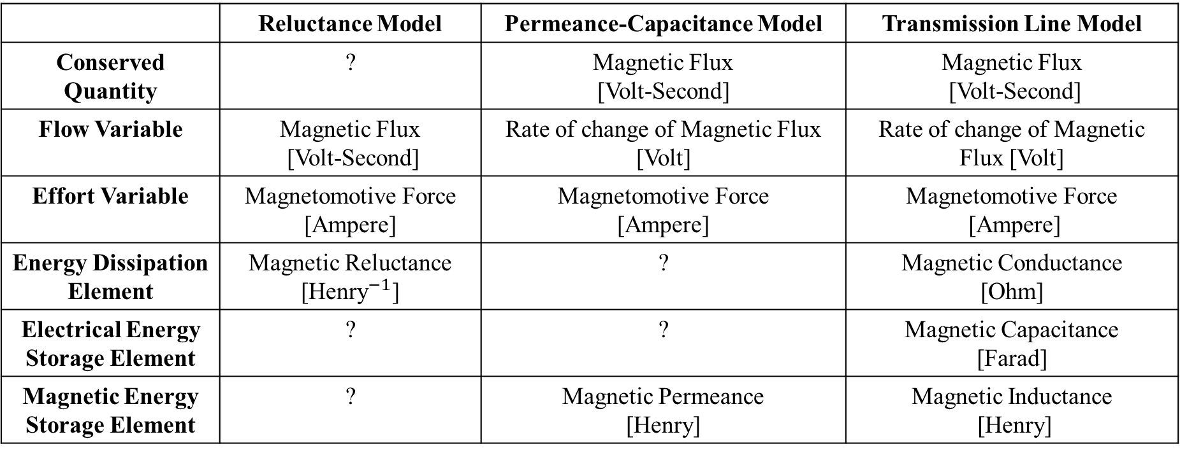
2.4. Comparison of Different Models
 | Reluctance Model | Permeance-Capacitance Model | Transmission Line Model
Conserved Quantity | ? | Magnetic Flux [Volt-Second] | Magnetic Flux [Volt-Second]
Flow Variable | Magnetic Flux [Volt-Second] | Rate of change of Magnetic Flux [Volt] | Rate of change of Magnetic Flux [Volt]
Effort Variable | Magnetomotive Force [Ampere] | Magnetomotive Force [Ampere] | Magnetomotive Force [Ampere]
Energy Dissipation Element | Magnetic Reluctance [${\text{Henry}}^{−1}$] | ? | Magnetic Conductance [Ohm]
Electrical Energy Storage Element | ? | ? | Magnetic Capacitance [Farad]
Magnetic Energy Storage Element | ? | Magnetic Permeance [Henry] | Magnetic Inductance [Henry]

Slide 49
3. Electromagnetic Simulations and MEEP Simulator

Slide 50
3.1. Finite Difference Time Domain Method

Slide 51
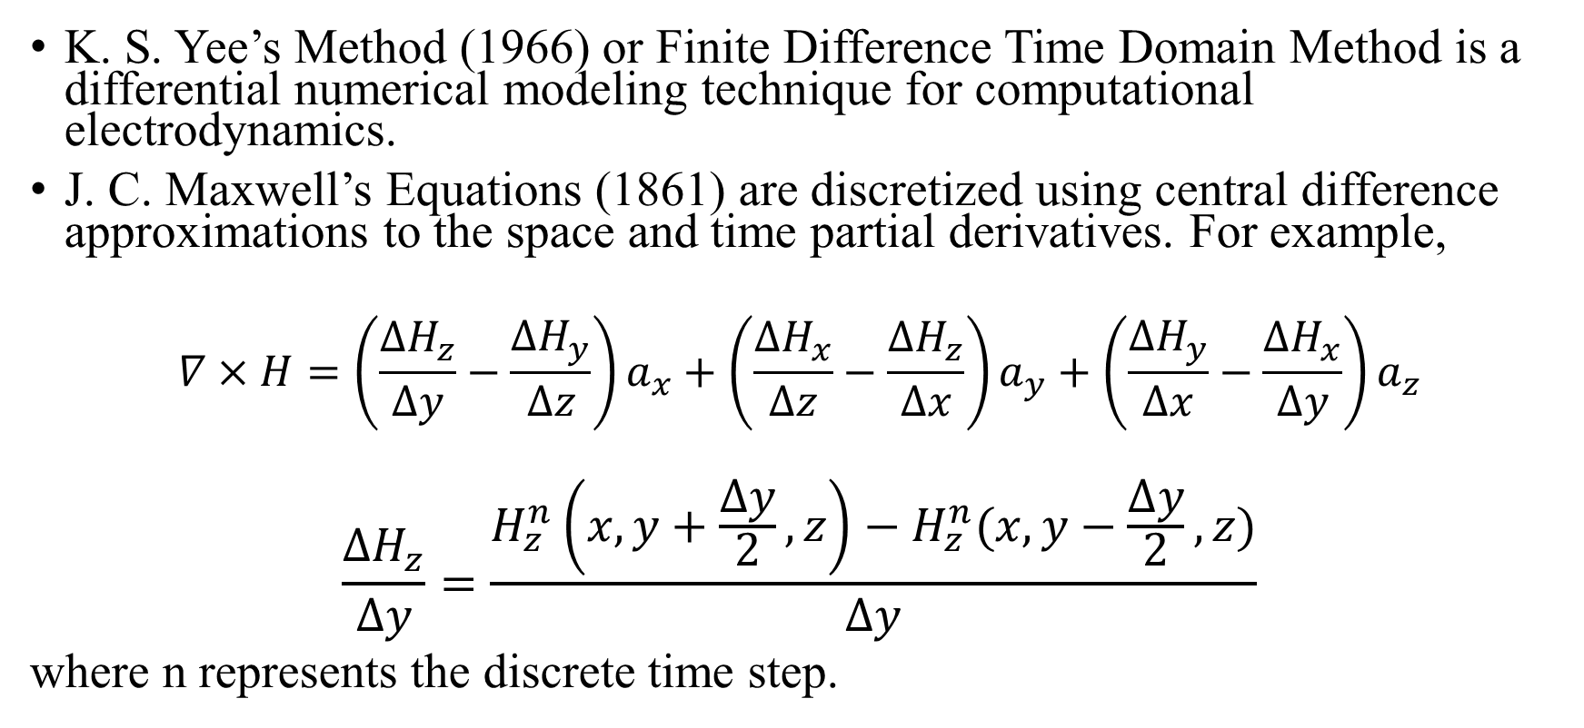
3.1. Finite Difference Time Domain Method
K. S. Yee’s Method (1966) or Finite Difference Time Domain Method is a differential numerical modeling technique for computational electrodynamics.
J. C. Maxwell’s Equations (1861) are discretized using central difference approximations to the space and time partial derivatives. For example,
$$∇×H=\left(\frac{∆H_{z}}{∆y}−\frac{∆H_{y}}{∆z}\right)a_{x}+\left(\frac{∆H_{x}}{∆z}−\frac{∆H_{z}}{∆x}\right)a_{y}+\left(\frac{∆H_{y}}{∆x}−\frac{∆H_{x}}{∆y}\right)a_{z}$$
$$\frac{∆H_{z}}{∆y}=\frac{H_{z}^{n}\left(x,y+\frac{∆y}{2},z\right)−H_{z}^{n}(x,y−\frac{∆y}{2},z)}{∆y}$$
where n represents the discrete time step.

Slide 52
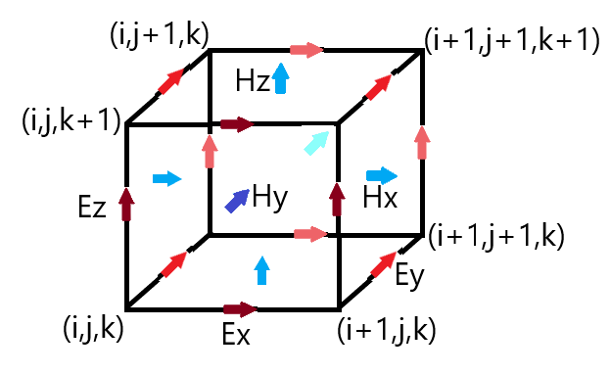
3.1. Yee Lattice
Finite Difference Time Domain Method discretizes space into a grid of small elements called Yee Lattice (1966). The different field components at a grid location are stored in the edges and faces of a cubic element. They are evolved in discrete time steps.

Slide 53
3.2. Introduction to MEEP Simulator

Slide 54
3.2. Introduction to MEEP
MEEP (2006) is a script based Simulator for modeling the time domain and frequency domain behavior of a variety of arbitrary materials including anisotropic, dispersive, non-linear and gyrotropic media.
C++ interface: Features variable resolution and normalized units.
Material Library: Sample data for several materials is provided in libraries for building accurate test structures.
Current Sources: A wide variety of electric or magnetic current sources can be simulated.
Derived components: Electric/ Magnetic/ Thermal Energy Density, Poynting Flux etc. can be evaluated.
Mathematical operations: Averaging, symmetry and integration are allowed in cylindrical and rectangular coordinates.
Data Visualization: The fields can be printed as image or video files.

Slide 55
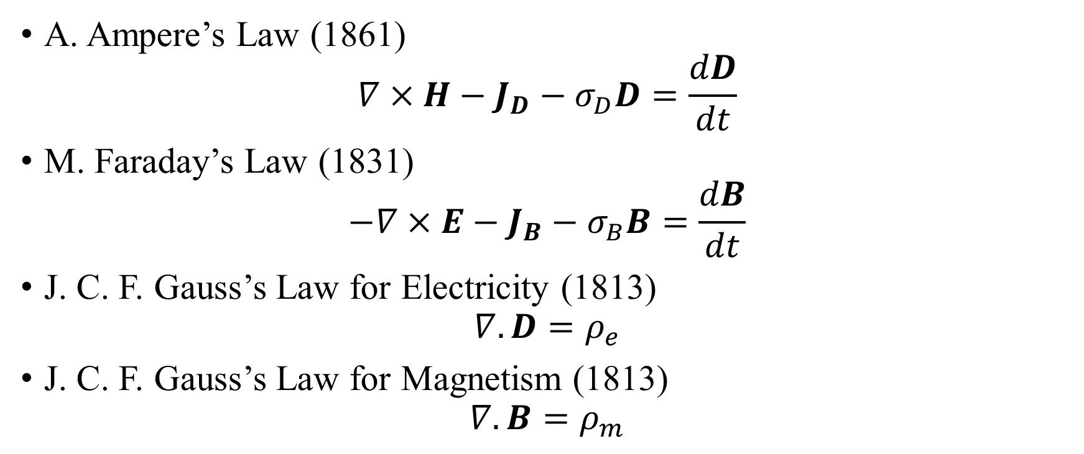
3.2. MEEP: Fully Symmetric Maxwell’s Equations
A. Ampere’s Law (1861)
$$∇×H−J_{D}−σ_{D}D=\frac{dD}{dt}$$
M. Faraday’s Law (1831)
$$−∇×E−J_{B}−σ_{B}B=\frac{dB}{dt}$$
J. C. F. Gauss’s Law for Electricity (1813)
$$∇.D=ρ_{e}$$
J. C. F. Gauss’s Law for Magnetism (1813)
$$∇.B=ρ_{m}$$

Slide 56
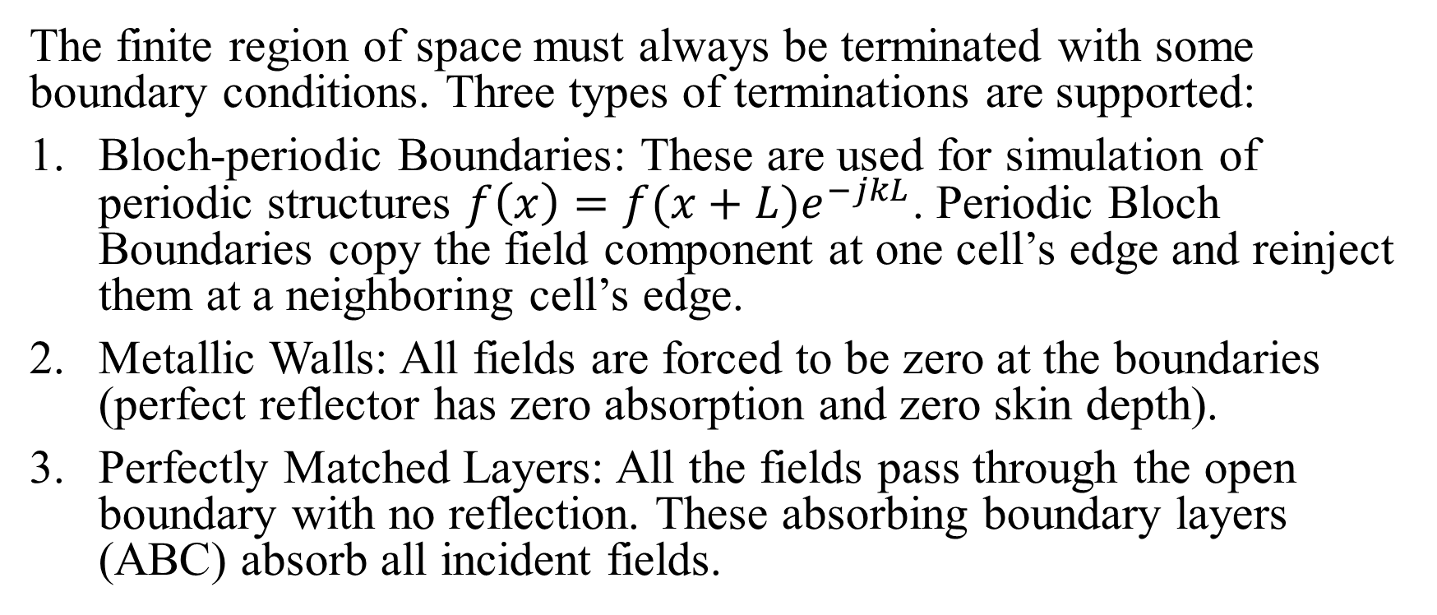
3.2. MEEP: Boundary Conditions
The finite region of space must always be terminated with some boundary conditions. Three types of terminations are supported:
Bloch-periodic Boundaries: These are used for simulation of periodic structures $f\left(x\right)=f(x+L)e^{−jkL}$. Periodic Bloch Boundaries copy the field component at one cell’s edge and reinject them at a neighboring cell’s edge.
Metallic Walls: All fields are forced to be zero at the boundaries (perfect reflector has zero absorption and zero skin depth).
Perfectly Matched Layers: All the fields pass through the open boundary with no reflection. These absorbing boundary layers (ABC) absorb all incident fields.

Slide 57
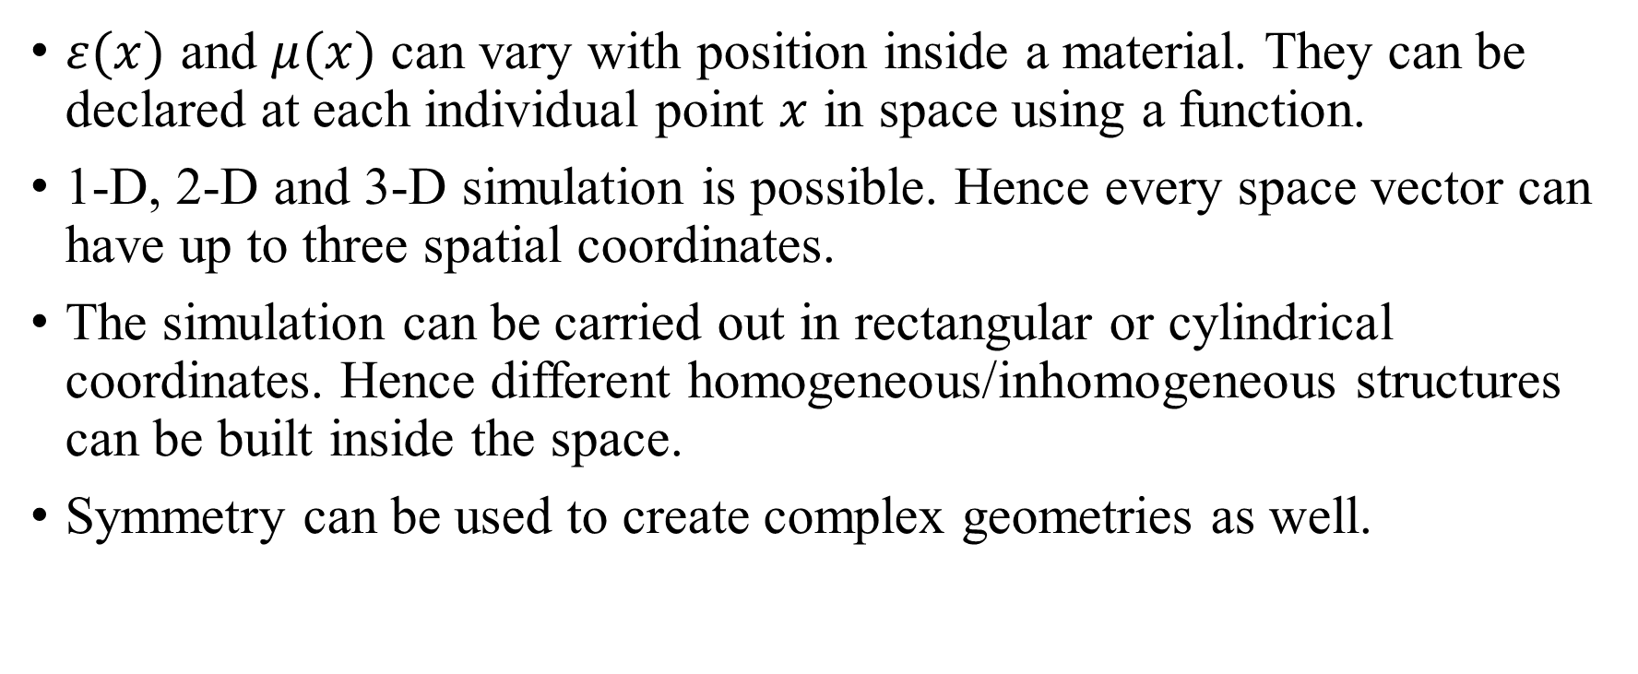
3.2. MEEP: Material Inhomogeneity
$ε(x)$ and $μ(x)$ can vary with position inside a material. They can be declared at each individual point $x$ in space using a function.
1-D, 2-D and 3-D simulation is possible. Hence every space vector can have up to three spatial coordinates.
The simulation can be carried out in rectangular or cylindrical coordinates. Hence different homogeneous/inhomogeneous structures can be built inside the space.
Symmetry can be used to create complex geometries as well.

Slide 58
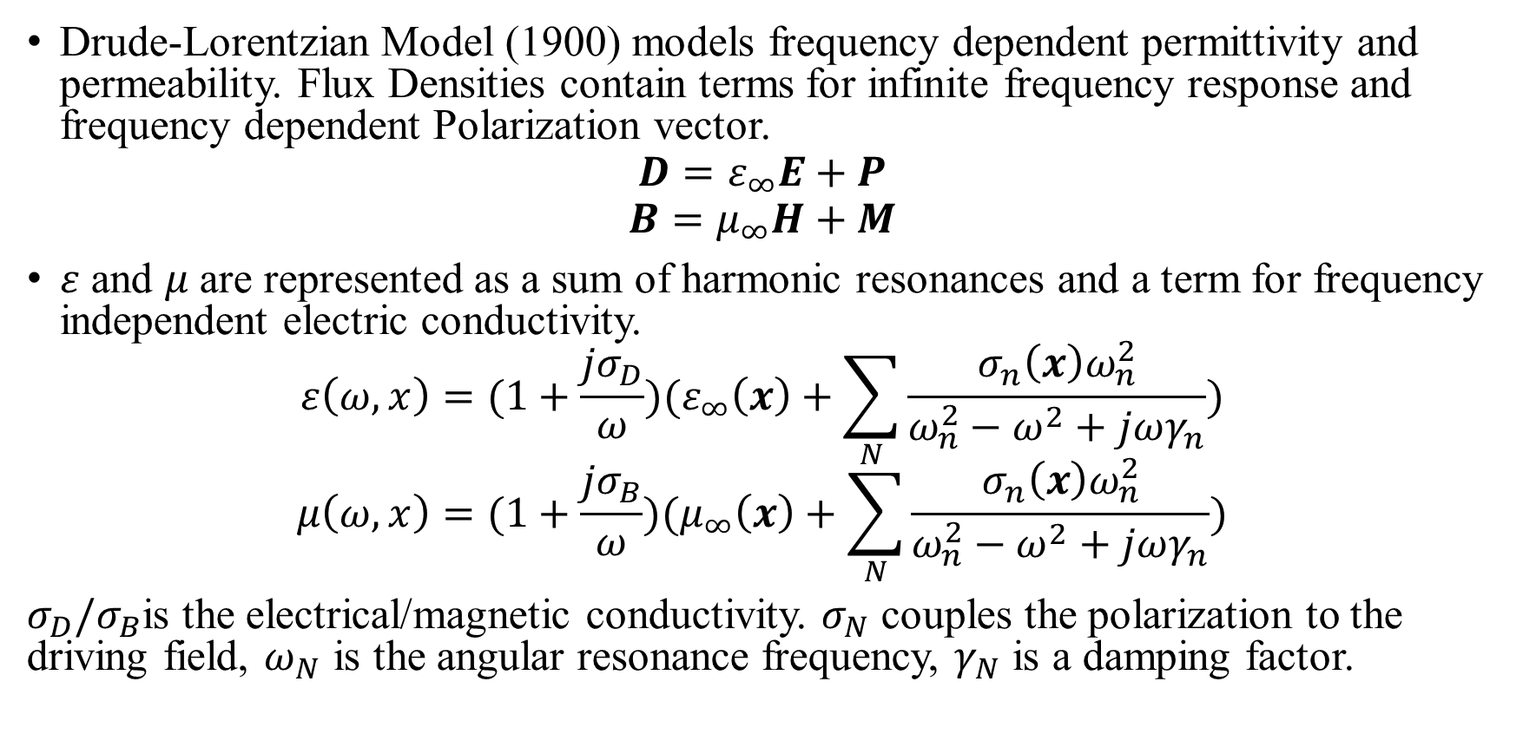
3.2. MEEP: Material Dispersion
Drude-Lorentzian Model (1900) models frequency dependent permittivity and permeability. Flux Densities contain terms for infinite frequency response and frequency dependent Polarization vector.
$$D=ε_{∞}E+P$$
$$B=μ_{∞}H+M$$
$ε$ and $μ$are represented as a sum of harmonic resonances and a term for frequency independent electric conductivity.
$$ε\left(ω,x\right)=(1+\frac{jσ_{D}}{ω})(ε_{∞}\left(x\right)+\sum_{N}{\frac{σ_{n}\left(x\right)ω_{n}^{2}}{ω_{n}^{2}−ω^{2}+jωγ_{n}}})$$
$$μ\left(ω,x\right)=(1+\frac{jσ_{B}}{ω})(μ_{∞}\left(x\right)+\sum_{N}{\frac{σ_{n}\left(x\right)ω_{n}^{2}}{ω_{n}^{2}−ω^{2}+jωγ_{n}}})$$
$σ_{D}/σ_{B}$is the electrical/magnetic conductivity. $σ_{N}$ couples the polarization to the driving field, $ω_{N}$ is the angular resonance frequency, $γ_{N}$ is a damping factor.

Slide 59
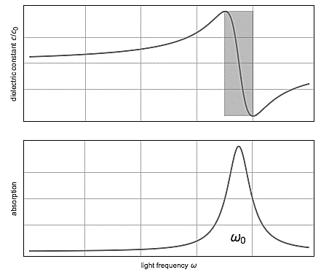
3.2. MEEP: Material Dispersion Drude-Lorentzian Model (1900)
Dispersion Drude-Lorentzian Model (1900) explains the electrodynamic properties of metals by regarding conduction band electrons as non-interacting electron gas.
When the material is excited by an external source of resonant frequency, the material absorption loss increases greatly. Electromagnetic Energy is converted into other forms of energy.

Slide 60
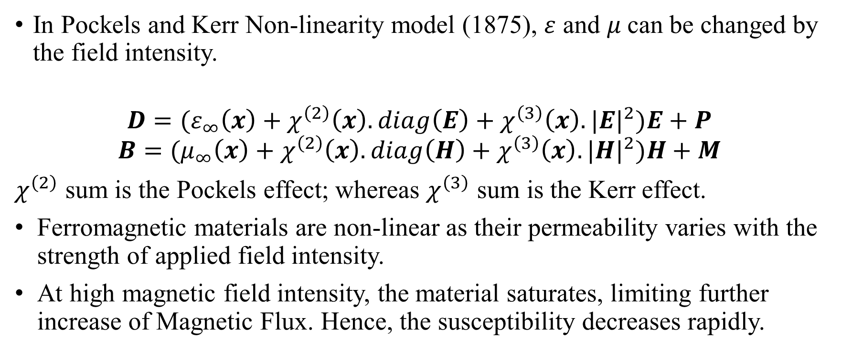
3.2. MEEP: Material Non-Linearity
In Pockels and Kerr Non-linearity model (1875), $ε$ and $μ$can be changed by the field intensity.
$$D=(ε_{∞}\left(x\right)+χ^{\left(2\right)}\left(x\right).diag\left(E\right)+χ^{\left(3\right)}\left(x\right).{|E|}^{2})E+P$$
$$B=(μ_{∞}\left(x\right)+χ^{\left(2\right)}\left(x\right).diag\left(H\right)+χ^{\left(3\right)}\left(x\right).{|H|}^{2})H+M$$
$χ^{\left(2\right)}$ sum is the Pockels effect; whereas $χ^{\left(3\right)}$ sum is the Kerr effect.
Ferromagnetic materials are non-linear as their permeability varies with the strength of applied field intensity.
At high magnetic field intensity, the material saturates, limiting further increase of Magnetic Flux. Hence, the susceptibility decreases rapidly.

Slide 61
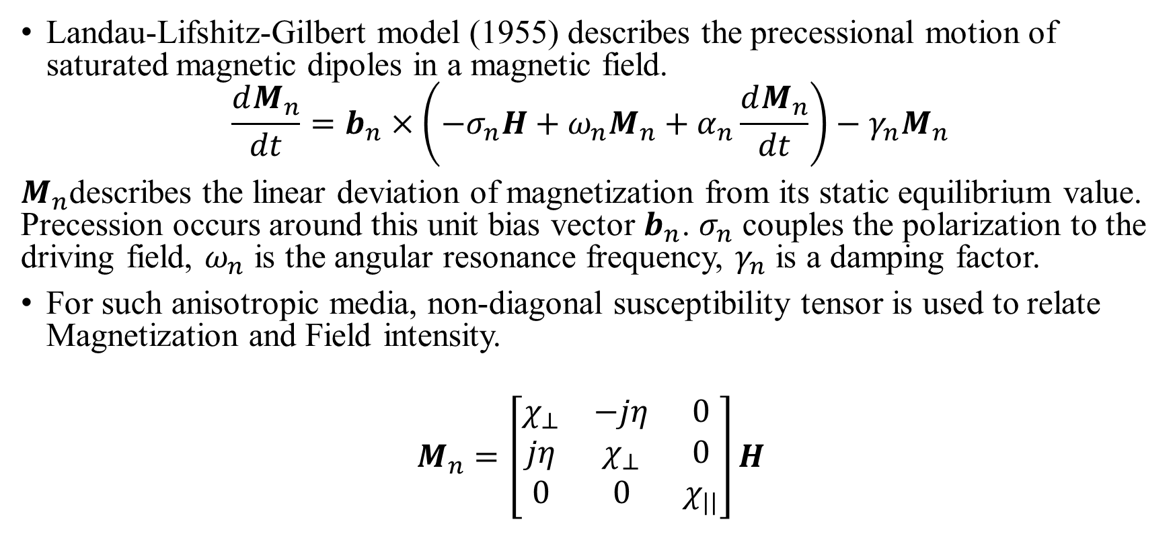
3.2. MEEP: Gyromagnetism
Landau-Lifshitz-Gilbert model (1955) describes the precessional motion of saturated magnetic dipoles in a magnetic field.
$$\frac{dM_{n}}{dt}=b_{n}×\left(−σ_{n}H+ω_{n}M_{n}+α_{n}\frac{dM_{n}}{dt}\right)−γ_{n}M_{n}$$
$M_{n}$describes the linear deviation of magnetization from its static equilibrium value. Precession occurs around this unit bias vector $b_{n}$. $σ_{n}$ couples the polarization to the driving field, $ω_{n}$ is the angular resonance frequency, $γ_{n}$ is a damping factor.
For such anisotropic media, non-diagonal susceptibility tensor is used to relate Magnetization and Field intensity.
$$M_{n}=\left[\begin{matrix}χ_{⊥} & −jη & 0 \\ jη & χ_{⊥} & 0 \\ 0 & 0 & χ_{||}\end{matrix}\right]H$$

Slide 62
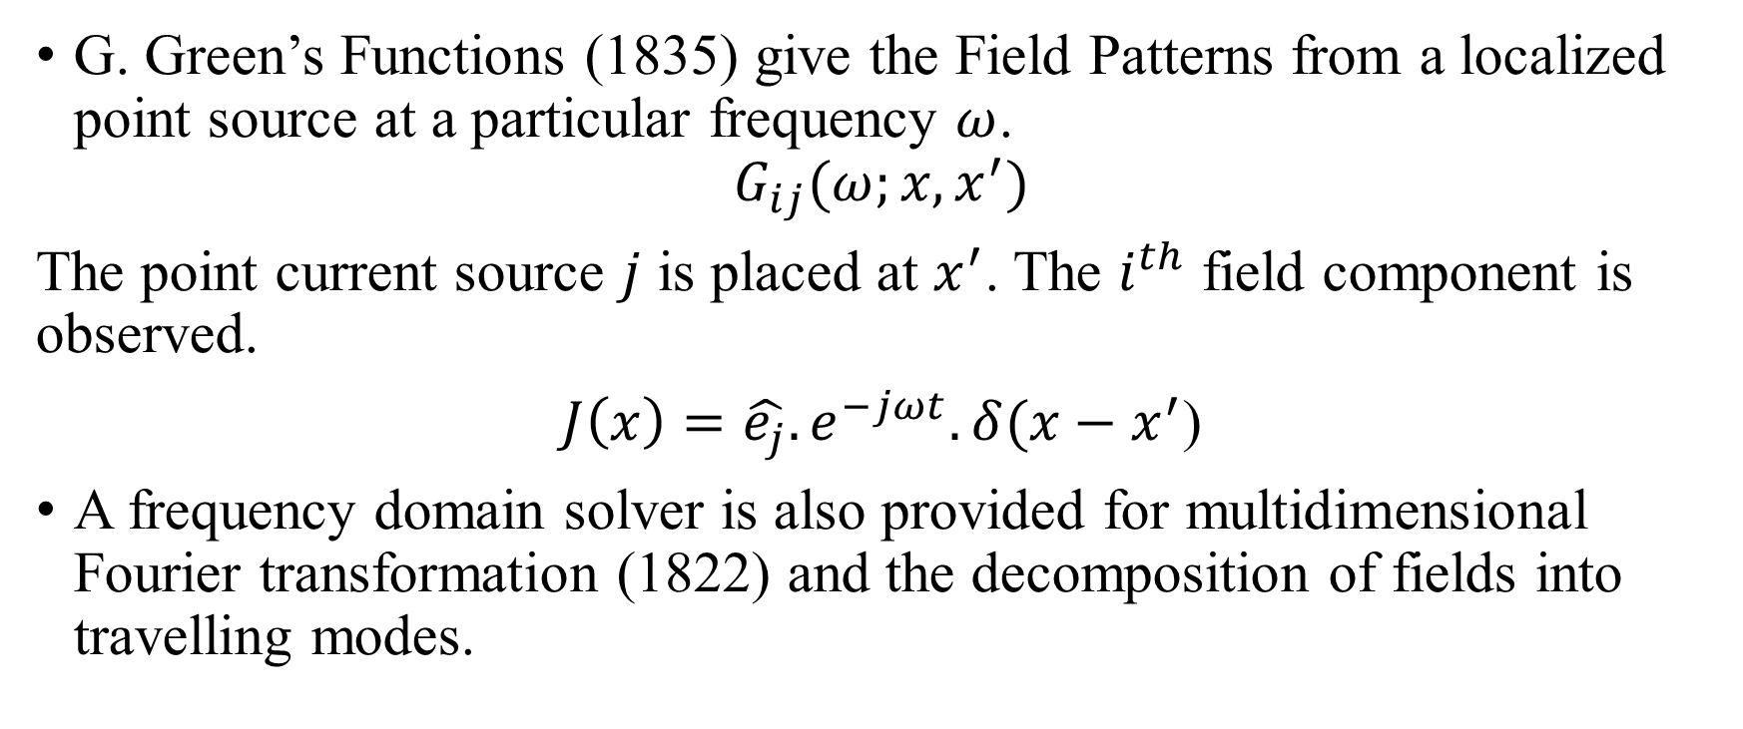
3.2. MEEP: Field Patterns and Green’s Functions
G. Green’s Functions (1835) give the Field Patterns from a localized point source at a particular frequency $ω$.
$$G_{ij}(ω;x,x^{′})$$
The point current source $j$ is placed at $x^{′}$. The $i^{th}$ field component is observed.
$J\left(x\right)=\hat{e_{j}}.e^{−jωt}.δ(x−x^{′}$)
A frequency domain solver is also provided for multidimensional Fourier transformation (1822) and the decomposition of fields into travelling modes.

Slide 63
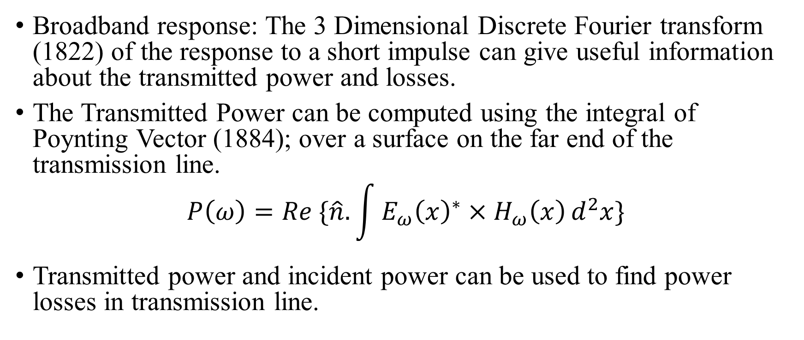
3.2. MEEP: Transmittance Spectra
Broadband response: The 3 Dimensional Discrete Fourier transform (1822) of the response to a short impulse can give useful information about the transmitted power and losses.
The Transmitted Power can be computed using the integral of Poynting Vector (1884); over a surface on the far end of the transmission line.
$$P\left(ω\right)=Re \{\hat{n}.\int{{E_{ω}\left(x\right)}^{∗}×H_{ω}\left(x\right)}d^{2}x\}$$
Transmitted power and incident power can be used to find power losses in transmission line.

Slide 64
4. Simulation of Magnetic Transmission Lines

Slide 65
4.1. MEEP Simulation of Non-linear Dispersive, Gyromagnetic Magnetic Transmission Line

Slide 66
4.1. MEEP Simulations for Magnetic Transmission Lines
The Magnetic Transmission Lines were constructed for inhomogeneous, dispersive, non-linear ferromagnetic conductors like Manganese, Zinc and Cobalt alloys.
The Transmission Lines were excited using continuous soft electric current sources.
The multi-dimensional discrete Fourier transform (1822) was used to determine the Broadband Response.

Slide 67
4.1. MEEP Algorithm for simulating Magnetic Transmission Lines
Build Grid and Geometrical Structures for transformer, windings and boundaries.
Set 𝜀, 𝜇, 𝜎, Material Inhomogeneity, Dispersion and Non-Linearity Model Parameters.
Add volume current sources, set resolution and run Simulation for desired discrete steps.

Slide 68
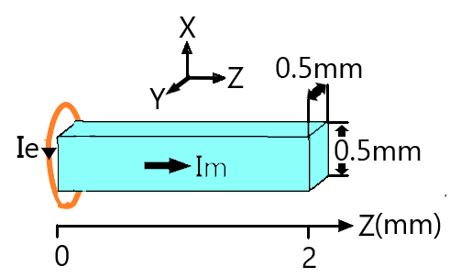
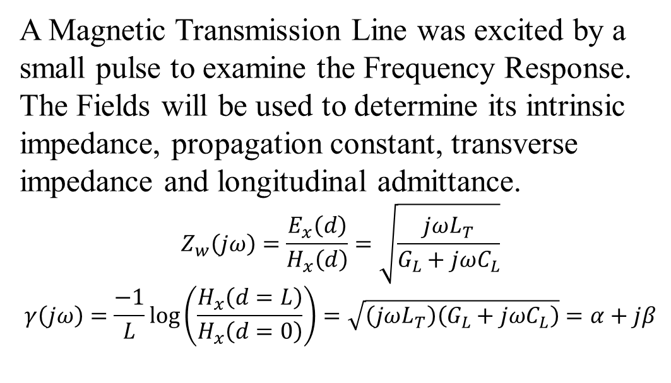
4.1. MEEP Simulations for Magnetic Transmission Lines
A Magnetic Transmission Line was excited by a small pulse to examine the Frequency Response. The Fields will be used to determine its intrinsic impedance, propagation constant, transverse impedance and longitudinal admittance.
$$Z_{w}\left(jω\right)=\frac{E_{x}\left(d\right)}{H_{x}\left(d\right)}=\sqrt{\frac{jωL_{T}}{G_{L}+jωC_{L}}}$$
$$γ\left(jω\right)=\frac{−1}{L}\log\left(\frac{H_{x}\left(d=L\right)}{H_{x}\left(d=0\right)}\right)=\sqrt{\left(jωL_{T}\right)\left(G_{L}+jωC_{L}\right)}=α+jβ$$

Slide 69












4.1. Longitudinal Fields
 | X | Y | Z
H
B
E
D

Slide 70












4.1. Transverse Fields
 | X | Y | Z
H
B
E
D

Slide 71
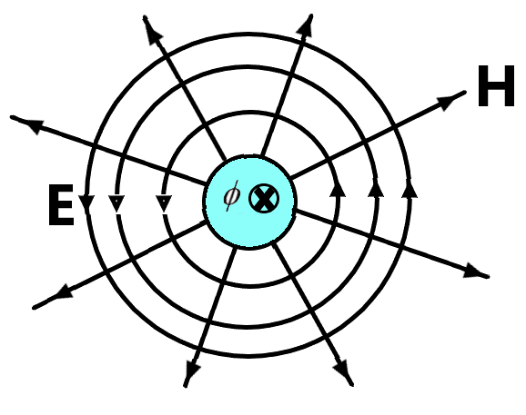

4.1. Field Map for Magnetic Transmission Line
1. Magnetic Displacement Current
$$I_{m,disp}=\frac{dΦ}{dt}$$
2. External Electric Field
$$E\left(r\right)=\frac{I_{m,disp}}{2πr}$$
3. External Magnetic Field
$$H\left(r\right)=\frac{V_{m}}{r}$$
4. Propagation Constant
$$γ=\sqrt{(jωμ)(σ_{e}+jωε)}=α+jβ$$
5. Intrinsic wave impedance
$$Z_{w}=\frac{V_{m}}{I_{m,disp}}=\sqrt{\frac{jωμ}{σ_{e}+jωε}}$$

Slide 72
4.1. Dispersion and Skin Effect

Slide 73

4.1. Evolution of Gaussian Pulse

Slide 74
4.1. Fourier Transform of Magnetic Field

Slide 75
4.1. Intrinsic Wave Impedance and Propagation Constant of Magnetic Transmission Line

Slide 76

4.1. Longitudinal Admittance
The Longitudinal Admittance was calculated using the relation:
$$\frac{γ(jω)}{Z_{w}(jω)}=\sqrt{\left(jωL_{T}\right)\left(G_{L}+jωC_{L}\right)}\sqrt{\frac{G_{L}+jωC_{L}}{jωL_{T}}}$$
$$Y=G_{L}+jωC_{L}=\frac{ℛ_{m}}{jω}+jωC_{L}$$

Slide 77

4.1. Transverse Impedance
The Transverse Impedance was calculated using the relation:
$$Z_{w}\left(jω\right)γ\left(jω\right)=\sqrt{\left(jωL_{T}\right)\left(G_{L}+jωC_{L}\right)}\sqrt{\frac{jωL_{T}}{G_{L}+jωC_{L}}}$$
$$Z=jωL_{T}$$

Slide 78
4.2. Wideband Transformer Simulation in MEEP

Slide 79

4.2. Introduction to Wideband Transformer
A wideband transformer passes a frequency band of several decades and is designed to handle complex waveforms like rectangular pulses.
It is used for impedance matching, voltage/ current transformation, DC isolation, mixing, power splitting, coupling and signal inversion.

Slide 80

4.2. Wideband Transformer Magnetic Transmission Line Model
The wideband Transformer is made from ferromagnetic material hence its behavior can be predicted by using Magnetic Transmission Line model.

Slide 81
4.2. Wideband Transformer Simulation in MEEP
A wideband transformer will be excited by a small pulse to examine the Frequency Response. The 3 dimensional discrete Fourier Transform was used to determine Broadband Response.
Build Grid and Geometrical Structures for transformer, windings and boundaries.
Set 𝜀, 𝜇, 𝜎, Material Inhomogeneity, Dispersion and Non-Linearity Model Parameters.
Add volume current sources, set resolution and run Simulation for desired discrete steps.
Apply 3D Discrete Fourier Transform to find transmitted Poynting Flux and Broadband Response.

Slide 82

4.2. Geometry of Wideband Transformer
A 300 MHz – 3 GHz wideband transformer was be simulated to study the effects of Magnetic Transmission Lines parameters on its frequency response.

Slide 83












4.2. Visualization of Electromagnetic Fields
 | X | Y | Z
H
B
E
D

Slide 84
4.2. Wideband Transformer Insertion Loss
The low frequency droop below 300 MHz is attributed to the diminishing shunt magnetizing reactance and high series capacitive reactance.
The mid-band insertion loss is attributed to loss across the magnetic conductance.
Above 3.5 GHz, the attenuation constant increases, the magnetic reluctance increases, the permeability decreases and the shunt magnetic reactance drops. Hence magnetic losses increase as well.

Slide 85
5. Conclusion

Slide 86

5. Simulation for Magnetic Transmission Lines in MEEP
The Magnetic Transmission Line incorporates the following losses:
DC Resistance Loss Tangent $tanδ_{dc}$
Skin Effect Loss Tangent $tanδ_{se}$
Proximity Effect Loss Tangent $tanδ_{pe}$
Self Capacitance Dielectric Loss Tangent $tanδ_{cp}$
Self Capacitance Circulating Currents Loss Tangent $tanδ_{cs}$
Core Residual Loss Tangent $tanδ_{r}$
Core Eddy Current Loss Tangent $tanδ_{f}$
Core Hysteresis Loss Tangent $tanδ_{h}$

Slide 87
5. Limitations of MEEP simulator
The MEEP simulator can not be used to model the following magnetic effects:
Magnetostriction
Accoustic effects
Relativistic Effects
Magnetohydrodynamics
Gravitomagnetism

Slide 88
5. Cross Talk and Shielding
Magnetic coupling between magnetic transmission lines results in sharing of electromagnetic energy. This division of power is very useful in design of Radio frequency devices like sensors, antennas and communication systems. It is also very important in the working of DC and AC machines like induction motor, hysteresis motor and Reluctance motor.
The study of capacitive/ inductive coupling in Multi-Conductor Transmission Lines will provide useful knowledge about the Radiated/ Conducted Emissions and Radiated/ Conducted Susceptibility.

Slide 89
5. Conclusion and Scope for Further Work
Non-linear components must be used for simulating complex energy loss effects. Equivalent Magnetic circuits were used to simplify analysis of the transient and steady state behavior.
The power invariant Magnetic Transmission Line model can also be used for accurate modeling of
AC and DC Machines
Nanomagnetic Logic Devices and Magnetic Transistors
Magnetic Memory Devices and Spintronic devices
Circulators, Couplers, Filters, Power Dividers and Waveguides
Gyromagnetic Non-Linear Transmission Lines

Slide 90
References
[1] J. B. Faria, Multimodal propagation in multiconductor transmission lines. J. Electromag. Waves Appl. 2014, p. 1677–1702
[2] J. B. Faria, Formulation of Multiwire Magnetic Transmission-Line Theory, Progress in Electromagnetics Research B, Vol. 49, 2013, p. 177–195.
[3] J. B. Faria, Matrix theory of wave propagation in hybrid electric/magnetic multiwire transmission line systems, Journal of Electromagnetic Waves and Applications, Vol. 29, No. 7, 2015, p. 925–940.
[4] J. B. Faria, A physical model of the ideal transformer based on magnetic transmission line theory, Journal of Electromagnetic Waves and Applications, Vol. 27, No. 3, 2013, p. 365–373.
[5] J. B. Schneider, Understanding the Finite-Difference Time-Domain Method, 2017, p. 33-74.
[6] A. Oskooi, D. Roundy, M. Ibanescu, P. Bermel, J.D. Joannopoulos, and S.G. Johnson, MEEP: A flexible free-software package for electromagnetic simulations by the FDTD method, Computer Physics Communications, Vol. 181, 2010, p. 687-702.
[7] J. B. Faria, Complex reluctance of inhomogeneous Euler-Cauchy tubular ferrites taking into account frequency dependent complex permeability, Progress In Electromagnetics Research M, Vol. 25, 2012, p. 71–85.
[8] C. Paul, K. Whites and S. Nasar, Introduction to electromagnetic fields, 4th ed. Boston: WCB/McGraw-Hill, 1998, p.586-589.
[9] B. Sevcik and L. Brancık, Time-Domain Simulation of Nonuniform Multiconductor Transmission Lines in Matlab, International Journal of Mahematics and Computers in Simulation, Vol.5, No. 2, 2011, p. 1-8.

Slide 91
References
[10] G. Antonini, A general framework for the analysis of metamaterial transmission lines. Prog. Electromagn. Res. B., 2010, p. 353–373
[11] C. Caloz and T. Itoh, Electromagnetic Metamaterials: Transmission Line Theory and Microwave Applications, Wiley-IEEE Press, 2006, p. 27-58.
[12] IEEE, Standard for Validation of Computational Electromagnetic (CEM) Computer Modeling and Simulation, and Recommended Practice, Part I, IEEE, June 2008.
[13] C. Paul, Introduction to Electromagnetic Compatibility, 2nd ed. Kentucky: John Wiley and Sons, 2006, p. 559-710.
[14] L. Er-Ping, Computational Electromagnetics for Electromagnetic Compatibility/ Signal Integrity Analysis, IEEE EMC DL Talk, University of Missouri, 2008.
[15] T. C. Edwards and M. B. Steer, Foundations for Microstrip Circuit Design, 4th ed. Wiley-IEEE Press, 2016, p. 576-607.
[16] J. Dickens and A. Neuber, Material selection considerations for coaxial, ferrimagnetic-based nonlinear transmission lines, Journal of Applied Physics, 113, 064904, 2013, p. 1-5.
[17] J. Parson, A. Neuber, J. Dickens and J. Mankowski, Investigation of a stripline transmission line structure for gyromagnetic nonlinear transmission line high power microwave sources, Review of Scientific Instruments, 87, 034706, 2016, p. 1-7.
[18] G. Dominguez, Power-Invariant Magnetic System Modeling, PhD Disseration, Texas A&M University, 2011, p. 45-64.

